Slide 1

Live and Verified News Community from Real Sources
Team Members
1-Hany Nady
2-Mena Melad
3-Mariam Arian
4-Martina Adel
5-Nora Wadie
Dr. Ahmed Omran
Eng. Moustafa Thabet
Eng. Abdel-rhman Ahmed

Slide 2

Idea
1
2
Investment
Solve Problem
Business
Number of users
No Hardware
3
4

Slide 3

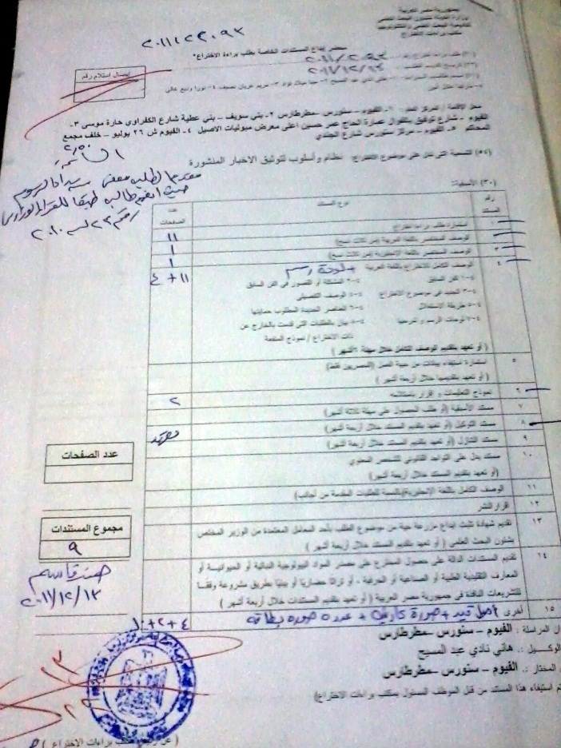
Idea
1
2
US Patent
Egyptian
Patent
Innovation
EFS ID: 12088963
ID: 2011/2093
App. Number: 61599445
Confirmation Number: 3711

Slide 4

Idea
1
2
Web Application
Mobile
Technical

Slide 5
Introduction
Every one follow News
1
Old Men
2
Youth
3
Business Men
4
Women and Girls
5
Specially in current state of the Arab World

Slide 6




Statistics
More than 1 billion and 277 million use online news all over the word
More than 65 % of internet users use online news in Egypt
More than 32 % errors in the online news
Reference : http://www.internetworldstats.com/stats.htm

Slide 7
Problem
There is no Verification on published news
Due to the professional life you don’t have the ability to :
Follow their news.
Comment or appearing in the sports programs

Slide 8
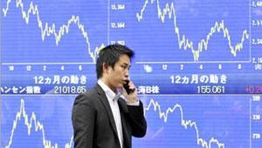
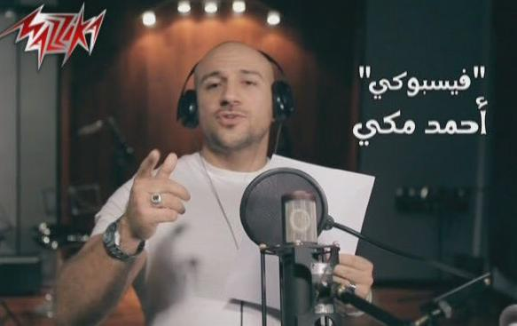
Stock Market :
Examples
2002 United Airlines
Droped by 76% in a few minutes.
Ended 11.2% below previous close.
Reference :
http://dc244.4shared.com/doc/buWjWMxB/preview.html
Celebrities :
Ahmed Mekky - Facebooky

Slide 9
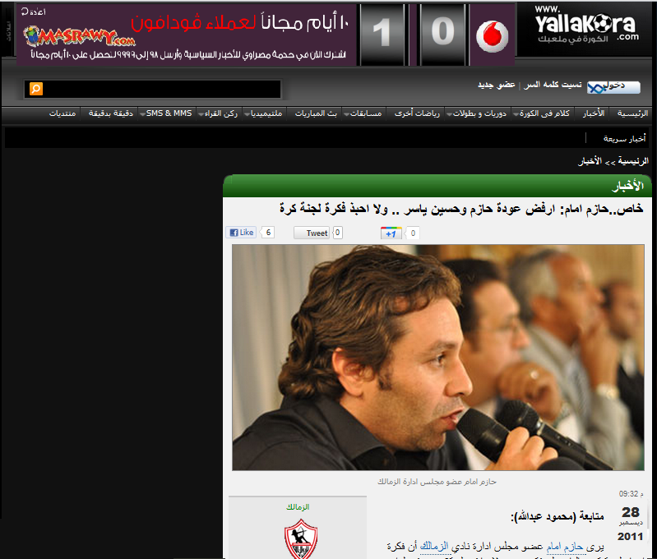
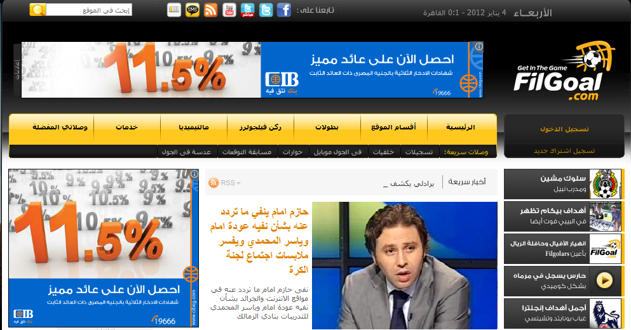


Examples

Slide 10




Examples
28 December 2011
4
January 2011
7 days different
Different sources

Slide 11

News Reader
Result
Readers start losing confidence in news sources.
Readers Beleive the Rumors.

Slide 12

How to solve this problem ?!!!
Then ..

Slide 13

Solution
Honest Gate
الثقـة بيـن إيديـك

Slide 14







Solution
1- Collect news from different sources.
2- Process this news to extract related entities.
3- Connect with this entities immediately and gain their comments.
4- Publish all news and related comments together on website.

Slide 15
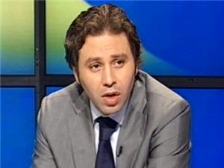
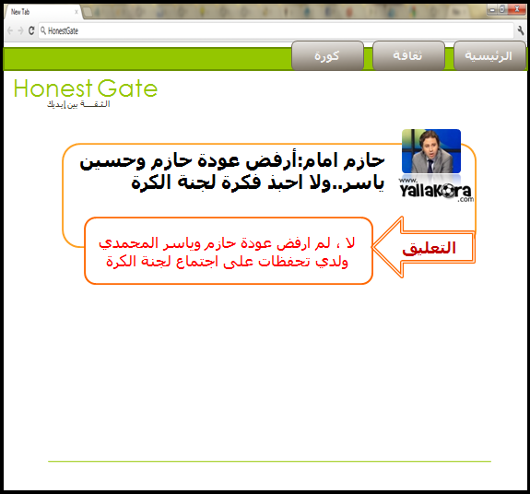
Solution
لا ، لم ارفض عودو ياسر
ولدى تحفظات على....

Slide 16

Solution
System Features

Slide 17




Features
1
Follow-up:-
Honest gate provide the ability for registered users to follow-up any entity.
Now

Slide 18



Features
New
Follow

Slide 19




Features
2
Evaluate sources:-
Through measuring the compatibility between the news and the comment we can decide weather it is true or not.
www.honestgate.com
90%
70%
60%
85%

Slide 20

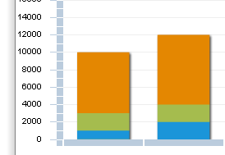
Features
Evaluation | Comment | News
False
True
False
True
Evaluation | Comment | News
True
True
False
True
Evaluation = 50% Reliable
Evaluation = 75% Reliable

Slide 21
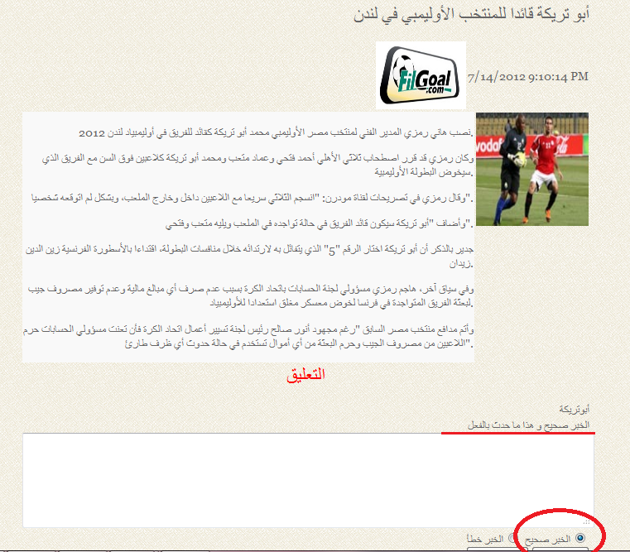

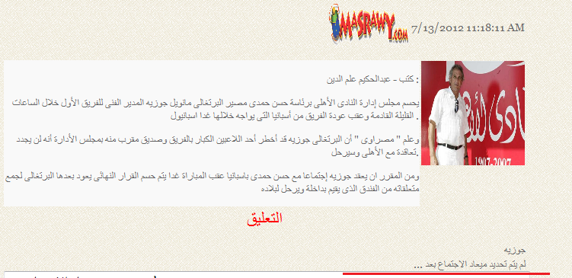

Features

Slide 22



Features
3
Receive notification:-
VIPs notified when they mentioned in any news on the site.
One new news

Slide 23

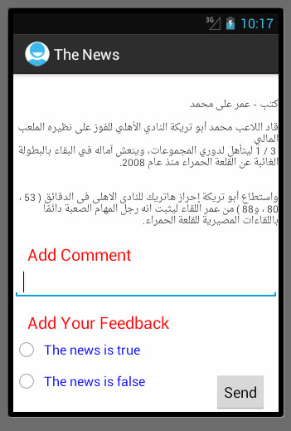
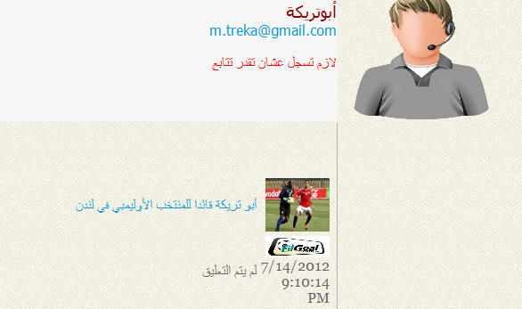
Features
4
Ability to connect with VIPS easily and gain comments:-
Direct connection with VIPs through website.
1-Web Application
2- Mobile Application

Slide 24

Benefits
System Benefits

Slide 25




Benefits
Save time:
Save efforts:
Ensure confidence in news:
Monitor news sources(Evaluate):

Slide 26
System Structure

Slide 27


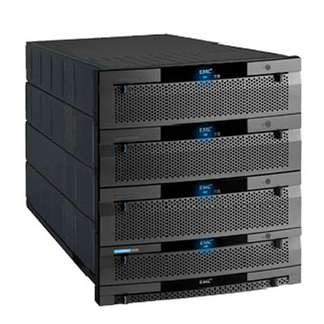
Major Parts
1
2
Information Extraction
Data mining
Data Flow
3
4
Data
representation
Data storage

Slide 28
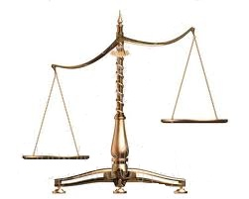

Information Extraction
1
Why RSS(Really Simple Syndication)?
1
Most News Websites Uses RSS Feeds
2
Simplicity
3
Run time

Slide 29
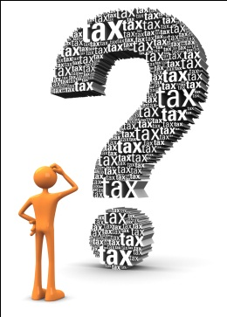

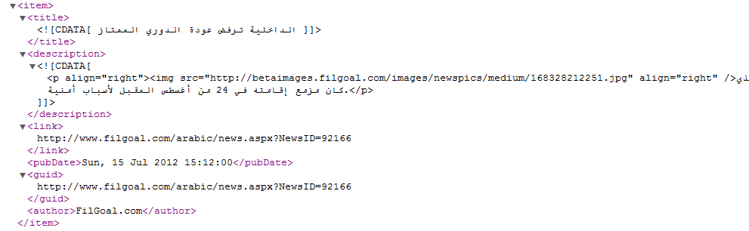
Information Extraction
1
Is RSS enough for news extraction?
No

Slide 30

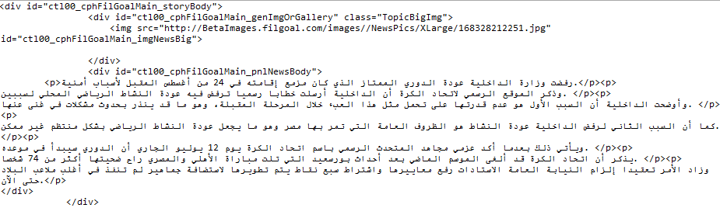
Information Extraction
1
Web Crawling

Slide 31
Major Parts
1
2
Information Extraction
Data mining
Data Flow
3
4
Data
representation
Data storage

Slide 32
Data Mining
2
1
Extract Related entities
Approaches
Linguistic
Mathematical
Cosine Similarity technique

Slide 33
Data Mining
2
2
Resolve ambiguity problem
Example
المسجلين
الخبر
احمد حسن
حسام حسن
العميد يفوز بالدوري والاحتفالات تعم ميت عقبة

Slide 34
Data Mining
2
1
Extract Related entities
2
Resolve ambiguity problem
Example
المسجلين
الخبر
احمد حسن
حسام حسن
العميد يفوز بالدوري والاحتفالات تعم ميت عقبة

Slide 35

Data Mining
2
المسجلين
الخبر
احمد حسن
الزمالك
ميت عقبة
الصقر
العميد
حسام حسن
التوأم
المصري
بورسعيد
العميد
العميد يفوز بالدوري والاحتفالات تعم ميت عقبة

Slide 36
Major Parts
1
2
Information Extraction
Data mining
Data Flow
3
4
Data
representation
Data storage

Slide 37

Data Storage
3
PC
Android
I Phone
BlackBerry
XML
WebService
Encapsulation
Platform
Database

Slide 38
Major Parts
1
2
Information Extraction
Data mining
Data Flow
3
4
Data
representation
Data storage

Slide 39
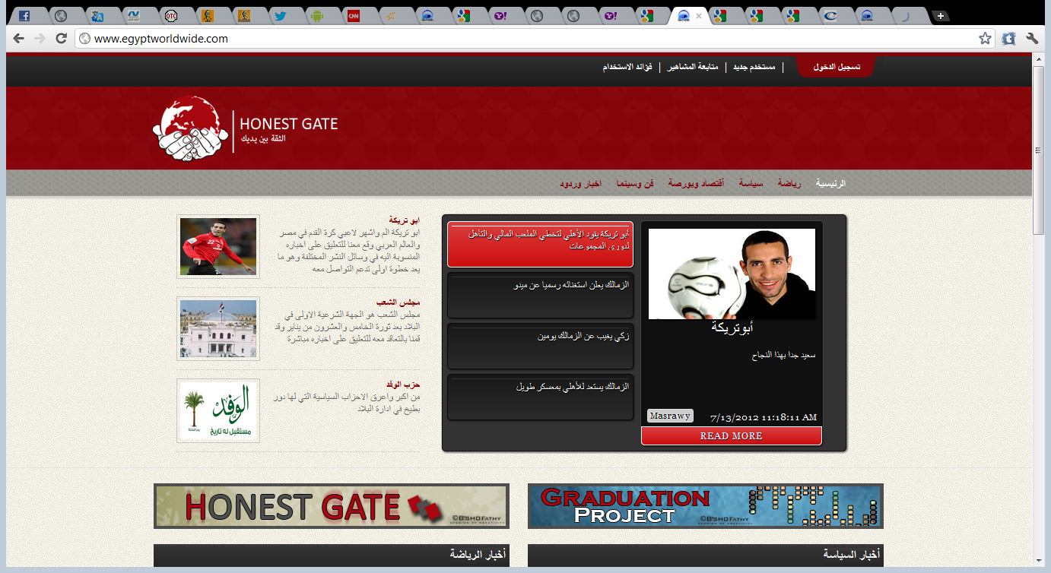
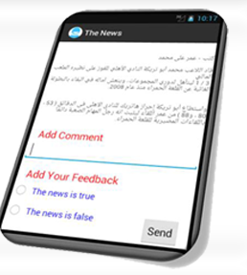
Data representation
4
Portal
1
http://fb.egyptworldwide.com/
2
Website
http://www.egyptworldwide.com/
3
Mobile App
Available for VIP users
Portal

Slide 40
Implementation
Tools
1
ASP. Net Framework 4
Sql Server 2008
2
3
Android
Market
Resources

Slide 41
System Architecture
Conclusion
RSS Feeds
Portal
Abstract News
Crawler
Detailed News
Mining
Related News
Insert Data
Webservice
Interface
Retrieve Data
Insert
Retrieve
Database

Slide 42
Overview
…. Video ….

Slide 43



Conclusion
We provide a developed system that introduce the following:
The system collect news from different sources
1

Slide 44
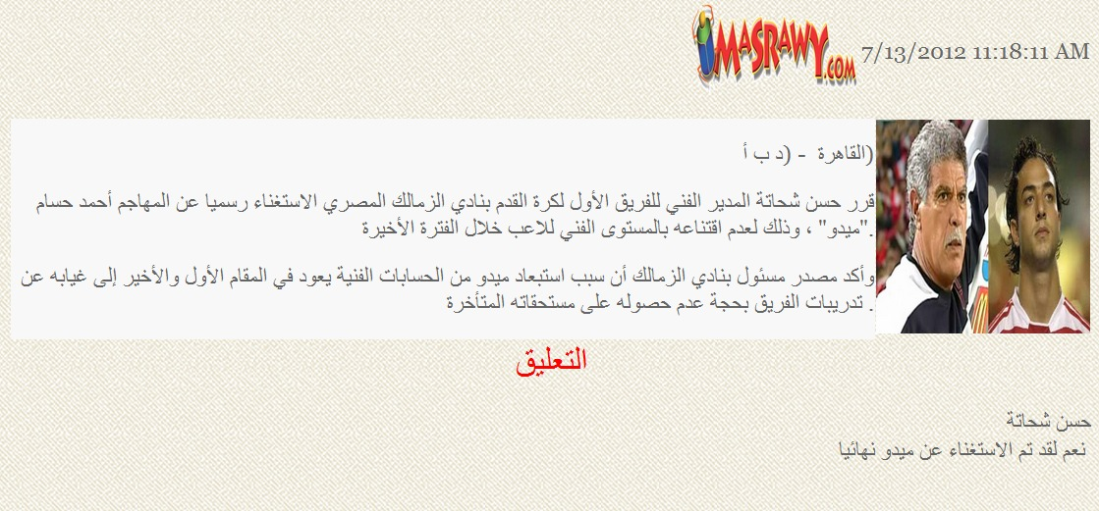
Conclusion
Ensuring confidence.
2

Slide 45

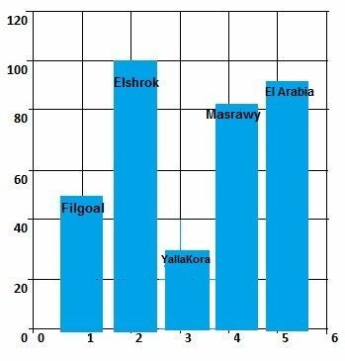
Conclusion
Evaluation
3

Slide 46
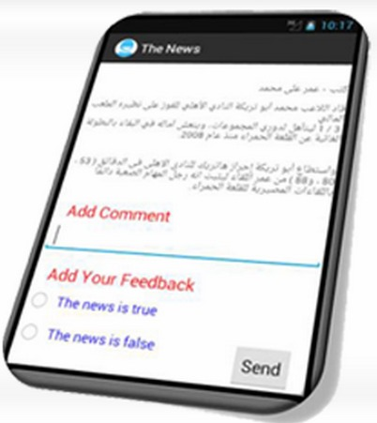
Conclusion
Mobile application
4

Slide 47
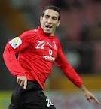

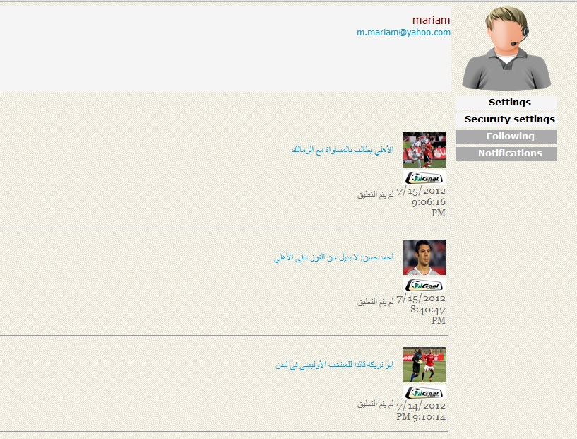
Conclusion
Following up
5

Slide 48
Marketing
Our system obtained:
with ID: 2011/2093
with EFS ID: 12088963, Application Number: 61599445 and Confirmation Number: 3711
We make a business plan and begin to communicate with very important investors : Eng/Tamer Elnhas .
We communicate with important users :President of the ruling Nour Salafi
patent from Egypt
patent from America

Slide 49

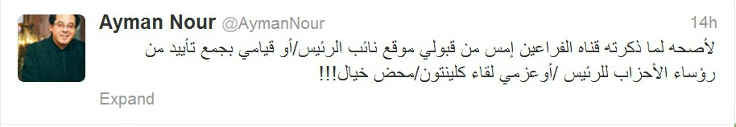
Future Work
Connection with Twitter.
1

Slide 50
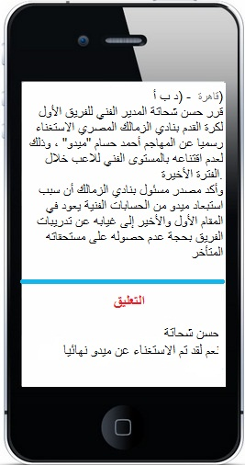
Future Work
Provide mobile application to all users
2

Slide 51
The mobile application will be developed to work in all platforms
Future Work
3
Android
iPhone
Nokia's Symbian
BlackBerry

Slide 52

Future Work
Collect global news and connect with them owners
4

Slide 53
Future Work
Data mining will improved using linguistics approach instead of mathematical approach .
5

Slide 54

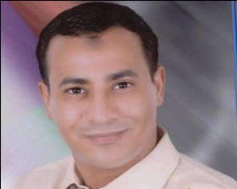

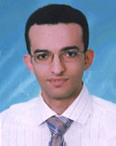
Dr/Nabila Mohammed Hassan
Dr/Ahmed Omran
Supervisor
Eng/Moustafa Thabet
Assistant
Eng/Abd Elrhman
Assistant

Slide 55
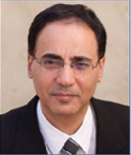
Special Thanks
Dr/Cherif Algreatly

